Slide 1

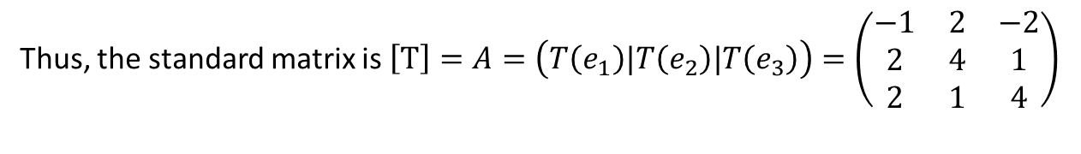

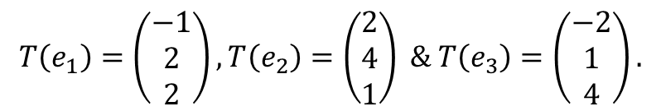
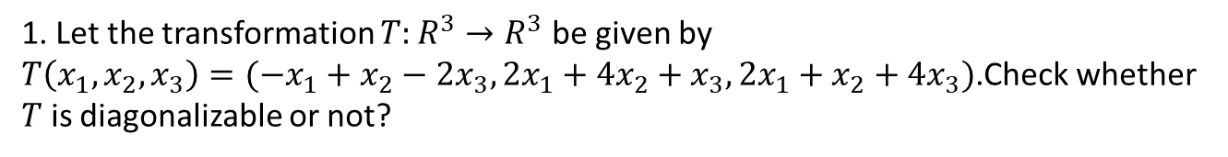

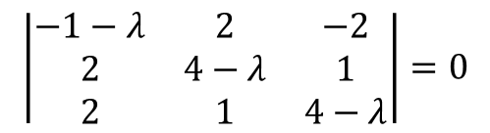


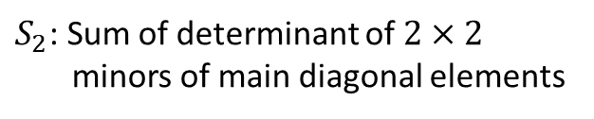
1. Let the transformation $T:R^{3}→R^{3}$ be given by
$T\left(x_{1},x_{2},x_{3}\right)=(−x_{1}+x_{2}−2x_{3},2x_{1}+{4x}_{2}+x_{3},2x_{1}+x_{2}+4x_{3})$.Check whether
$T$ is diagonalizable or not?
Solution:
$$T\left(e_{1}\right)=\left(\begin{matrix}−1 \\ 2 \\ 2\end{matrix}\right),T\left(e_{2}\right)=\left(\begin{matrix}2 \\ 4 \\ 1\end{matrix}\right) \& T\left(e_{3}\right)=\left(\begin{matrix}−2 \\ 1 \\ 4\end{matrix}\right).$$
Thus, the standard matrix is $\left[T\right]=A=\left(T\left(e_{1}\right)|T\left(e_{2}\right)|T\left(e_{3}\right)\right)=\left(\begin{matrix}−1 & 2 & −2 \\ 2 & 4 & 1 \\ 2 & 1 & 4\end{matrix}\right)$
The characteristic equation of $A$ is given by
$$\left|\begin{matrix}−1−λ & 2 & −2 \\ 2 & 4−λ & 1 \\ 2 & 1 & 4−λ\end{matrix}\right|=0$$
The characteristic equation of A can be obtained from
$$λ^{3}−S_{1}λ^{2}+S_{2}λ−S_{3}=0$$
$S_{1}$: Trace of $(A)$
Now
$S_{2}$: Sum of determinant of $2×2$
minors of main diagonal elements
$$S_{1}=−1+4+4=7,$$
$S_{3}$: $|A|$

Slide 2



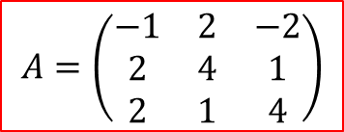










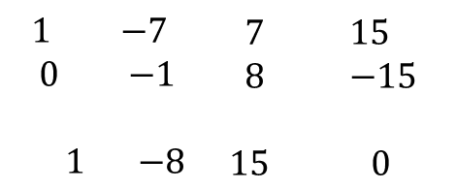



$$S_{2}= \left|\begin{matrix}4 & 1 \\ 1 & 4\end{matrix}\right|+\left|\begin{matrix}−1 & −2 \\ 2 & 4\end{matrix}\right|+\left|\begin{matrix}−1 & 2 \\ 2 & 4\end{matrix}\right|$$
$$A=\left(\begin{matrix}−1 & 2 & −2 \\ 2 & 4 & 1 \\ 2 & 1 & 4\end{matrix}\right)$$
$$=15+\left(0\right)+(−4−4)$$
$$S_{2}=7$$
$$λ^{3}−S_{1}λ^{2}+S_{2}λ−S_{3}=0$$
$S_{3}=$ $\left|A\right|=−15−12+12=−15$
Therefore, the characteristic equation of $A$ is
$λ^{3}−7λ^{2}+7λ+15=0$ ------------------(1)
The eigenvalues of $A$ are the roots of the characteristic equation (1) of $A$.
$λ=−1$ is one of the root of the characteristic equation (1), thus
$$−1$$
$\begin{matrix}1 & −7 & \begin{matrix}7 & 15\end{matrix}\end{matrix}$
$$\begin{matrix}0 & −1 & \begin{matrix}8 & −15\end{matrix}\end{matrix}$$
$$\begin{matrix}1 & −8 & \begin{matrix}15 & 0\end{matrix}\end{matrix}$$
Now, we get $λ^{2}−8λ+15=0$
$$\left(λ−3\right)\left(λ−5\right)=0$$
$$λ=3$$
&
$$λ=5$$
Therefore, the eigenvalues of the given matrix A are
$λ=−1$,
$$λ=3$$
&
$$λ=5$$

Slide 3

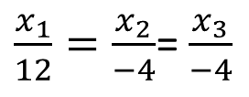
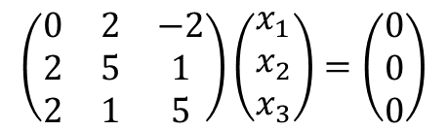
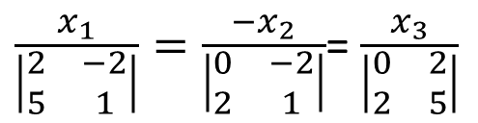

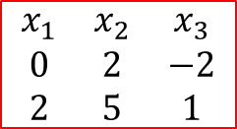
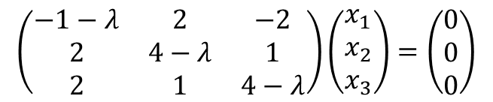
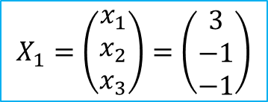



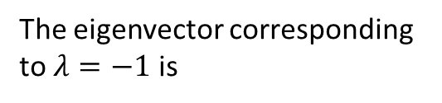
Find Eigenvector corresponding to the eigenvalue $λ=−1$
The eigenvector corresponding to the eigenvalue $λ$ can be obtained from
$$\left(A−λI\right)X=0$$
$$\left(\begin{matrix}−1−λ & 2 & −2 \\ 2 & 4−λ & 1 \\ 2 & 1 & 4−λ\end{matrix}\right)\left(\begin{matrix}x_{1} \\ x_{2} \\ x_{3}\end{matrix}\right)=\left(\begin{matrix}0 \\ 0 \\ 0\end{matrix}\right)$$
$λ=−1$ implies,
$$\left(\begin{matrix}0 & 2 & −2 \\ 2 & 5 & 1 \\ 2 & 1 & 5\end{matrix}\right)\left(\begin{matrix}x_{1} \\ x_{2} \\ x_{3}\end{matrix}\right)=\left(\begin{matrix}0 \\ 0 \\ 0\end{matrix}\right)$$
Rewriting as system gives
$$2x_{2}−2x_{3}=0$$
$$\begin{matrix}x_{1} & x_{2} & x_{3} \\ 0 & 2 & −2 \\ 2 & 5 & 1\end{matrix}$$
$$2x_{1}+5x_{2}+x_{3}=0$$
$$2x_{1}+x_{2}+5x_{3}=0$$
Solve the system,
The eigenvector corresponding to $λ=−1$ is
$\frac{x_{1}}{\left|\begin{matrix}2 & −2 \\ 5 & 1\end{matrix}\right|}=\frac{−x_{2}}{\left|\begin{matrix}0 & −2 \\ 2 & 1\end{matrix}\right|}$= $\frac{x_{3}}{\left|\begin{matrix}0 & 2 \\ 2 & 5\end{matrix}\right|}$
$$X_{1}=\left(\begin{matrix}x_{1} \\ x_{2} \\ x_{3}\end{matrix}\right)=\left(\begin{matrix}3 \\ −1 \\ −1\end{matrix}\right)$$
$\frac{x_{1}}{12}=\frac{x_{2}}{−4}$= $\frac{x_{3}}{−4}$

Slide 4

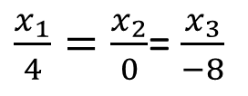
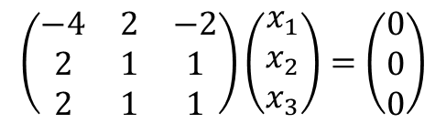
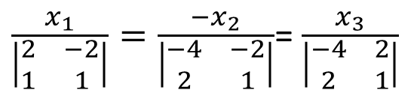

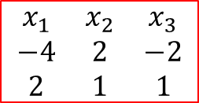



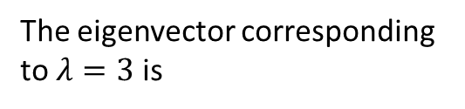
Find Eigenvector corresponding to the eigenvalue $λ=3$
The eigenvector corresponding to the eigenvalue $λ$ can be obtained from
$$\left(A−λI\right)X=0$$
$$\left(\begin{matrix}−1−λ & 2 & −2 \\ 2 & 4−λ & 1 \\ 2 & 1 & 4−λ\end{matrix}\right)\left(\begin{matrix}x_{1} \\ x_{2} \\ x_{3}\end{matrix}\right)=\left(\begin{matrix}0 \\ 0 \\ 0\end{matrix}\right)$$
$λ=3$ implies,
$$\left(\begin{matrix}−4 & 2 & −2 \\ 2 & 1 & 1 \\ 2 & 1 & 1\end{matrix}\right)\left(\begin{matrix}x_{1} \\ x_{2} \\ x_{3}\end{matrix}\right)=\left(\begin{matrix}0 \\ 0 \\ 0\end{matrix}\right)$$
Rewriting as system gives
$$−4x_{1}+2x_{2}−2x_{3}=0$$
$$\begin{matrix}x_{1} & x_{2} & x_{3} \\ −4 & 2 & −2 \\ 2 & 1 & 1\end{matrix}$$
$$2x_{1}+x_{2}+x_{3}=0$$
$$2x_{1}+x_{2}+x_{3}=0$$
Solve the system,
The eigenvector corresponding to $λ=3$ is
$\frac{x_{1}}{\left|\begin{matrix}2 & −2 \\ 1 & 1\end{matrix}\right|}=\frac{−x_{2}}{\left|\begin{matrix}−4 & −2 \\ 2 & 1\end{matrix}\right|}$= $\frac{x_{3}}{\left|\begin{matrix}−4 & 2 \\ 2 & 1\end{matrix}\right|}$
$$X_{2}=\left(\begin{matrix}x_{1} \\ x_{2} \\ x_{3}\end{matrix}\right)=\left(\begin{matrix}1 \\ 0 \\ −2\end{matrix}\right)$$
$\frac{x_{1}}{4}=\frac{x_{2}}{0}$= $\frac{x_{3}}{−8}$

Slide 5

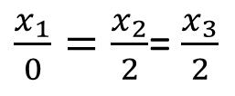
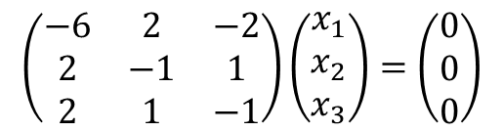
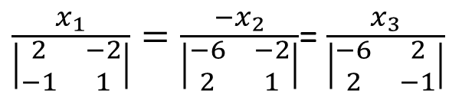

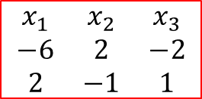
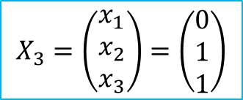


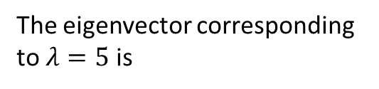
Find Eigenvector corresponding to the eigenvalue $λ=5$
The eigenvector corresponding to the eigenvalue $λ$ can be obtained from
$$\left(A−λI\right)X=0$$
$$\left(\begin{matrix}−1−λ & 2 & −2 \\ 2 & 4−λ & 1 \\ 2 & 1 & 4−λ\end{matrix}\right)\left(\begin{matrix}x_{1} \\ x_{2} \\ x_{3}\end{matrix}\right)=\left(\begin{matrix}0 \\ 0 \\ 0\end{matrix}\right)$$
$λ=5$ implies,
$$\left(\begin{matrix}−6 & 2 & −2 \\ 2 & −1 & 1 \\ 2 & 1 & −1\end{matrix}\right)\left(\begin{matrix}x_{1} \\ x_{2} \\ x_{3}\end{matrix}\right)=\left(\begin{matrix}0 \\ 0 \\ 0\end{matrix}\right)$$
Rewriting as system gives
$$−6x_{1}+2x_{2}−2x_{3}=0$$
$$\begin{matrix}x_{1} & x_{2} & x_{3} \\ −6 & 2 & −2 \\ 2 & −1 & 1\end{matrix}$$
$$2x_{1}−x_{2}+x_{3}=0$$
$$2x_{1}+x_{2}−x_{3}=0$$
Solve the system,
The eigenvector corresponding to $λ=5$ is
$\frac{x_{1}}{\left|\begin{matrix}2 & −2 \\ −1 & 1\end{matrix}\right|}=\frac{−x_{2}}{\left|\begin{matrix}−6 & −2 \\ 2 & 1\end{matrix}\right|}$= $\frac{x_{3}}{\left|\begin{matrix}−6 & 2 \\ 2 & −1\end{matrix}\right|}$
$$X_{3}=\left(\begin{matrix}x_{1} \\ x_{2} \\ x_{3}\end{matrix}\right)=\left(\begin{matrix}0 \\ 1 \\ 1\end{matrix}\right)$$
$\frac{x_{1}}{0}=\frac{x_{2}}{2}$= $\frac{x_{3}}{2}$

Slide 6
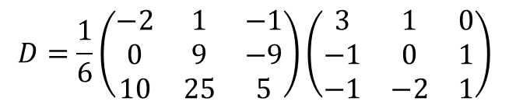
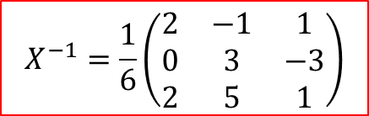
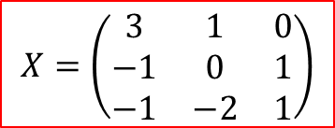
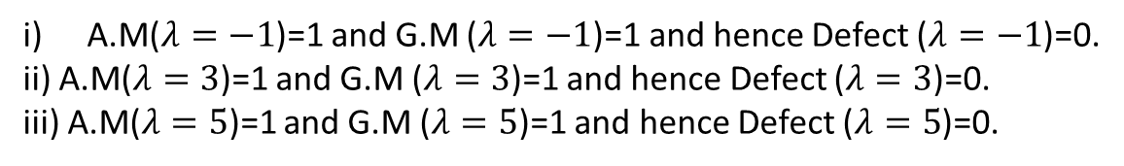

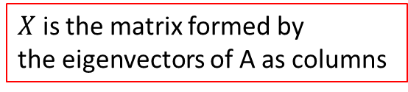


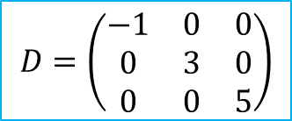
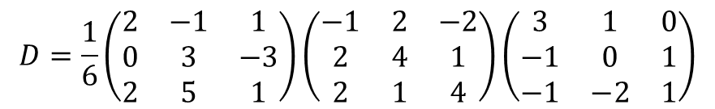
A.M($λ=−1$)=1 and G.M ($λ=−1$)=1 and hence Defect ($λ=−1$)=0.
ii) A.M($λ=3$)=1 and G.M ($λ=3$)=1 and hence Defect ($λ=3$)=0.
iii) A.M($λ=5$)=1 and G.M ($λ=5$)=1 and hence Defect ($λ=5$)=0.
Since, A.M and G.M are same for all the eigen values of A.
$Therefore T$ is diagonalizable.
Diagonalization:
$X$ is the matrix formed by
the eigenvectors of A as columns
where
$$D=X^{−1}AX$$
$$X=\left(\begin{matrix}3 & 1 & 0 \\ −1 & 0 & 1 \\ −1 & −2 & 1\end{matrix}\right)$$
$$D=\frac{1}{6}\left(\begin{matrix}2 & −1 & 1 \\ 0 & 3 & −3 \\ 2 & 5 & 1\end{matrix}\right)\left(\begin{matrix}−1 & 2 & −2 \\ 2 & 4 & 1 \\ 2 & 1 & 4\end{matrix}\right)\left(\begin{matrix}3 & 1 & 0 \\ −1 & 0 & 1 \\ −1 & −2 & 1\end{matrix}\right)$$
$$X^{−1}=\frac{1}{6}\left(\begin{matrix}2 & −1 & 1 \\ 0 & 3 & −3 \\ 2 & 5 & 1\end{matrix}\right)$$
$$D=\frac{1}{6}\left(\begin{matrix}−2 & 1 & −1 \\ 0 & 9 & −9 \\ 10 & 25 & 5\end{matrix}\right)\left(\begin{matrix}3 & 1 & 0 \\ −1 & 0 & 1 \\ −1 & −2 & 1\end{matrix}\right)$$
and
$$D=\left(\begin{matrix}−1 & 0 & 0 \\ 0 & 3 & 0 \\ 0 & 0 & 5\end{matrix}\right)$$
$$A=\left(\begin{matrix}−1 & 2 & −2 \\ 2 & 4 & 1 \\ 2 & 1 & 4\end{matrix}\right)$$

Slide 7
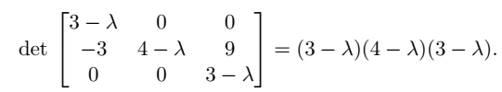

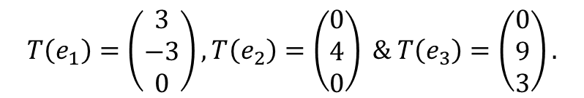
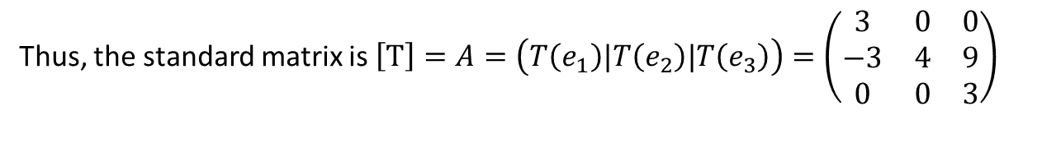

2. Let the transformation $T:R^{3}→R^{3}$ be given by
$T\left(x_{1},x_{2},x_{3}\right)=(3x_{1},−3x_{1}+{4x}_{2}+9x_{3},3x_{3})$.
Check whether $T$ is diagonalizable or not?
Solution:
$$T\left(e_{1}\right)=\left(\begin{matrix}3 \\ −3 \\ 0\end{matrix}\right),T\left(e_{2}\right)=\left(\begin{matrix}0 \\ 4 \\ 0\end{matrix}\right) \& T\left(e_{3}\right)=\left(\begin{matrix}0 \\ 9 \\ 3\end{matrix}\right).$$
Thus, the standard matrix is $\left[T\right]=A=\left(T\left(e_{1}\right)|T\left(e_{2}\right)|T\left(e_{3}\right)\right)=\left(\begin{matrix}3 & 0 & 0 \\ −3 & 4 & 9 \\ 0 & 0 & 3\end{matrix}\right)$
To find the eigenvalues of $A=\left(\begin{matrix}3 & 0 & 0 \\ −3 & 4 & 9 \\ 0 & 0 & 3\end{matrix}\right)$, we compute

Slide 8




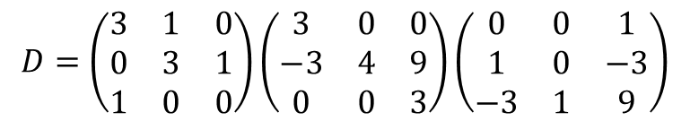

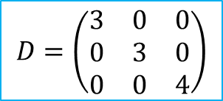
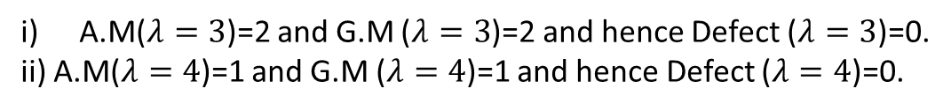
A.M($λ=3$)=2 and G.M ($λ=3$)=2 and hence Defect ($λ=3$)=0.
ii) A.M($λ=4$)=1 and G.M ($λ=4$)=1 and hence Defect ($λ=4$)=0.
Since, A.M and G.M are same for all the eigen values of A.
$Therefore T$ is diagonalizable.
Diagonalization:
$$D=X^{−1}AX$$
$$D=\left(\begin{matrix}3 & 1 & 0 \\ 0 & 3 & 1 \\ 1 & 0 & 0\end{matrix}\right)\left(\begin{matrix}3 & 0 & 0 \\ −3 & 4 & 9 \\ 0 & 0 & 3\end{matrix}\right)\left(\begin{matrix}0 & 0 & 1 \\ 1 & 0 & −3 \\ −3 & 1 & 9\end{matrix}\right)$$
$$D=\left(\begin{matrix}3 & 0 & 0 \\ 0 & 3 & 0 \\ 0 & 0 & 4\end{matrix}\right)$$

Slide 9
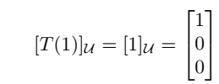

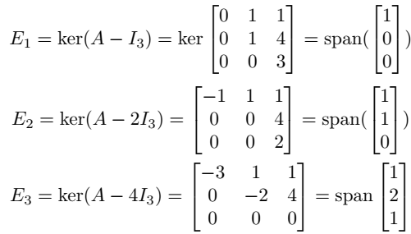
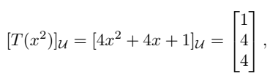



Slide 10








$$X$$

Slide 11
Thank you

